Slide 1


Ecotourism in Central Asia – Sharing experiences
J Marc Foggin, PhD
Plateau Perspectives
Email: marc.foggin@ubc.ca
Notes:
Dear colleagues, partners, friends,
First of all, I wish to thank our host, the Tourism Development Institute (TDI) of Uzbekistan. It is a pleasure to be here today; thank you for inviting me to participate in this webinar – as this is a great opportunity to exchange ideas and plans, along with some hopes and dreams for the development of beneficial ecotourism. And thank you, Jon, for introducing the issues that you have mentioned, including matters of recovery and growth at this time.
For my part, I wish to share with you now some of our own experiences in the development of ecotourism – based on the projects and unique opportunities that we have encountered in China and Kyrgyzstan.
I will begin with a few introductory remarks, in order to place our ecotourism experiences within the appropriate framework that we believe is crucial to maintain – that ecotourism is not simply one of many different forms of tourism, with a primary aim of ‘capturing’ more tourists, more investments, and more financial returns. Rather, ecotourism also is purpose-driven; in that it not only must be financially viable, but it also should bring benefit to local communities and should contribute to the conservation of nature. (But more on this later.) Following these introductory reminders, I will then share with you – in outline form – what we have been undertaking in western China and in Kyrgyzstan over the past few years.

Slide 2
Tourism as a sector | Tourism as a tool
Tourism is one of the fastest growing sectors of the economy (except 2020)
Tourism can be developed in a variety of different and complementary ways
  Centrally planned, with focus on regional economic development, larger numbers
  Organically, at local and community levels, strengthening livelihoods, specialized
  Hybrid option – both of the above, ensuring good enabling environments created
Nature and culture (including history) may be regarded mainly as ‘assets’ to utilize in the development of sustainable tourism at regional / national levels
However, beyond this, ecotourism (together with community based tourism) also could profitably be enabled, encouraged and strengthened to serve as a tool for selected purposes, e.g. for conservation and community development
Notes:
As we know, apart from this most unusual of years(!), tourism is a rapidly growing sector
There are different ways that the development of tourism can be supported – and this, in my opinion, is perhaps the main high-level issue that we are in fact addressing today. Not only are we considering how to expand ecotourism, but even more importantly, we are seeking to identify the main benefits of tourism – which should raise the very important question, Why would we wish to strengthen and to expand ecotourism in Uzbekistan?!
Nature and culture are very rich resources, so to speak, in Uzbekistan – unbelievably rich!
Further, if suitably enabled, ecotourism and other forms of community-oriented tourism could also serve to help the country meet its conservation and community development objectives and ambitions. There are great synergies to be found here.

Slide 3
Tourism as a tool for community development and the conservation of national biodiversity
National goals for sustainable development may be supported by ecotourism
By providing appropriate enabling environments encouraging development of community-based ecotourism operations, new opportunities may emerge
If designed with long-range ‘end purposes’ in mind, such as UN Global Goals and collaborations with international partners, ecotourism may be an ideal mechanism to achieve the desired purposes – building on strong synergies inherent in ecotourism for conservation and socioeconomic development
A joint strategy may be most fruitful, including nature-based tourism and cultural tourism (i.e., working from assets-based perspectives) along with ecotourism, as long as a clarity of thought is maintained regarding overall purposes of (eco)tourism and unique features of different tourism models
Notes:
Beyond a recognition that different development sectors, including tourism, can and should be developed in tandem, in synergistic ways, supporting each other… it is worth addressing one final matter, a matter that sometimes gives rise to confusion. Namely, the definition of Ecotourism. In short, ecotourism is tourism set in extraordinary natural environments (i.e., nature tourism) that also seeks to achieve local development and conservation outcomes. As said before, Ecotourism is not just ‘business as usual,’ it is also purpose-driven tourism.

Slide 4
Four models of ecotourism to consider…
Sharing experiences from the field
Notes:
As the head of a non-governmental organization as well as academic researcher, trained as conservation biologist with a focus on protected and conserved areas, from the last several years of involvement in development of ecotourism, four different models (or perspectives, approaches, or ways) of engaging with the ecotourism have become apparent to me – and in most instances, the way that we have approached ecotourism has been dependent on the partnerships we have. People, not impersonal assets, are a most critical ingredient.

Slide 5
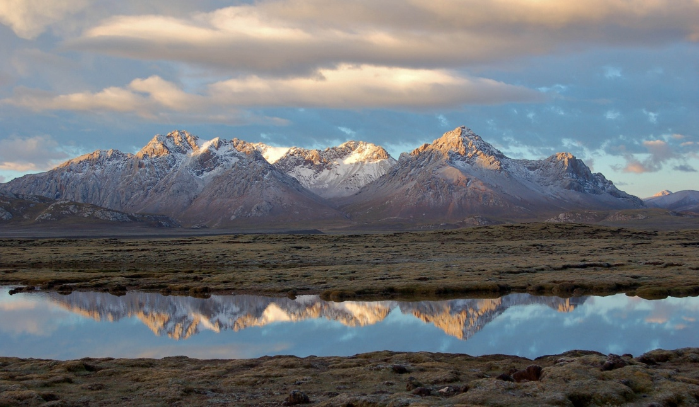
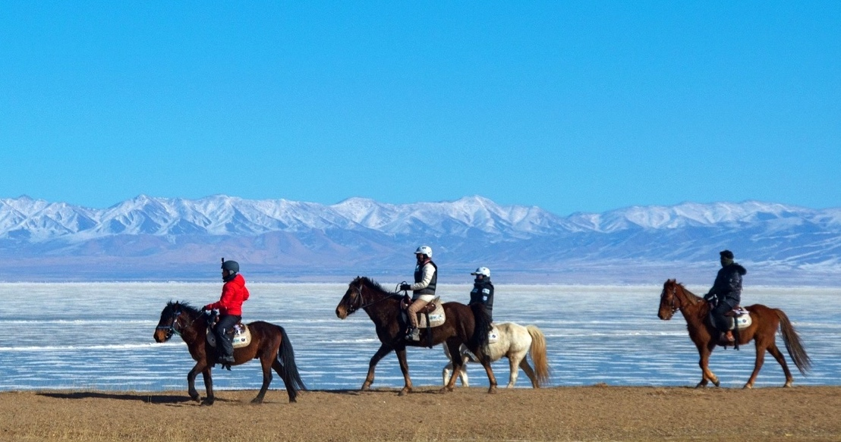
Western China
Horseback Planet Society: building a network of tourism entrepreneurs and local partners for wildlife conservation
Community co-management in the new national parks system in China
Working with protected areas
Focus on biodiversity and wildlife
Working with the business sector
Focus on local entrepreneurial spirit along with environmental concern
Notes:
In China, as new nature reserves have been established and management plans developed, and as China is now launching its first national parks in 2020, how parks relate to people is of fundamental importance – both for conservation success and for people’s wellbeing. In our experience, we introduced the notion or approach of ‘community co-management’ – and this has wide applicability. Nature reserve authorities, local communities and tourism authorities can all come together and develop mutually supportive and beneficial plans.
In the same period, we brought support to community-based entrepreneurs, e.g. providing basic training in tourism related skills, including outdoor activities, health and safety, as well as encouraging service-oriented attitudes and strengthening business management skills. All this was done mostly through a spin-off entity, Horseback Planet Society, a socially-minded enterprise that also has helped to foster the development of a network of local community partners and their family-based tourism endeavors.

Slide 6

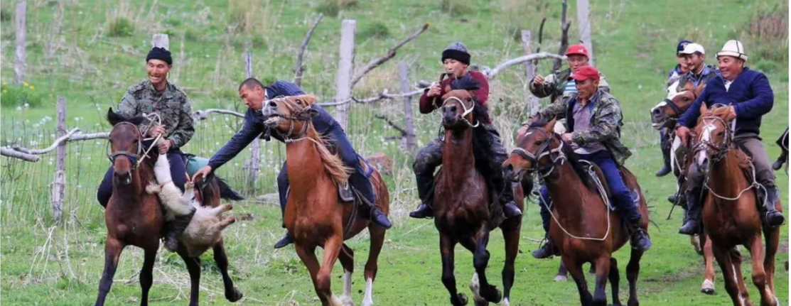
Kyrgyz Republic
Community conservancies: where former poachers are now serving as wildlife wardens and nature guides
Micro reserve: opportunity to show community commitment in action
Leveraging new land legislation
Focus on monitoring/demonstrating success, including ‘no harm’ noted as ecotourism ventures develop
Creating new livelihood strategies
Focus on sense of community and common identity, local pride in the environment and culture, hope for future wellbeing and good nature
Notes:
In Kyrgyzstan, by partnering with Ilbirs Foundation, which is mainly focused on supporting and strengthening community-based conservation initiatives in Kyrgyzstan & Central Asia, we have connected with several community associations engaged in the management of local protected areas (micro reserves, community consultancies) – and encouraging them with development of ecotourism simultaneously provides them with social and economic benefits in tandem with strengthening their on-going, community-driven environmental conservation efforts. This approach has helped strengthen wildlife protection; it also has strengthened community bonds, local pride in culture, and skills and capacity building.

Slide 7
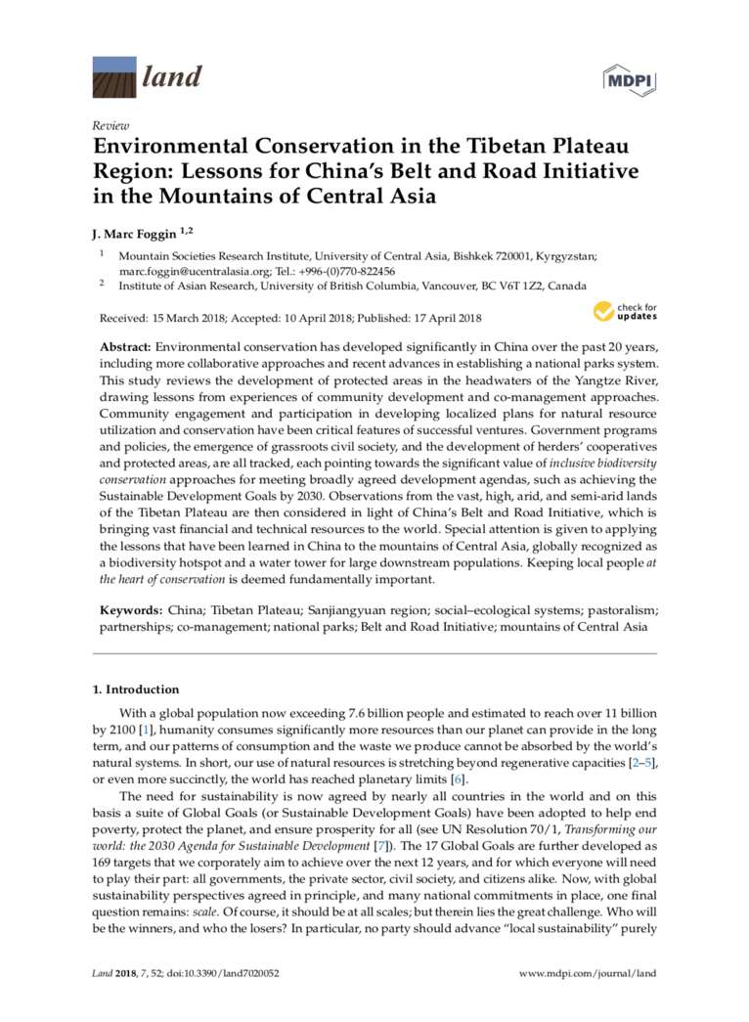
Community co-management in protected areas
China is formally launching its recently established network of national parks in 2020, incl. Sanjiangyuan National Park
Co-management approaches provide space for dialogue and development of mutually beneficial plans and actions
Community partnerships (e.g., community wardens) are an integral part of several national parks’ monitoring systems
Community-based tourism and ecotourism could serve parallel purposes, including biodiversity conservation
Notes:
More detailed information is available on all these approaches in ecotourism development. Please feel free to be in touch, as we can discuss in a lot more detail. In regard to developing partnerships and plans in context of nature reserves and national parks, most of our recent experiences are summarized in Environmental Conservation in the Tibetan Plateau Region… Again, the key to success at regional level has been successful partnership with local people and communities; this is the basis of ‘community co-management’ in which a wide range of interests and purposes are aligned, including conservation and community development.

Slide 8
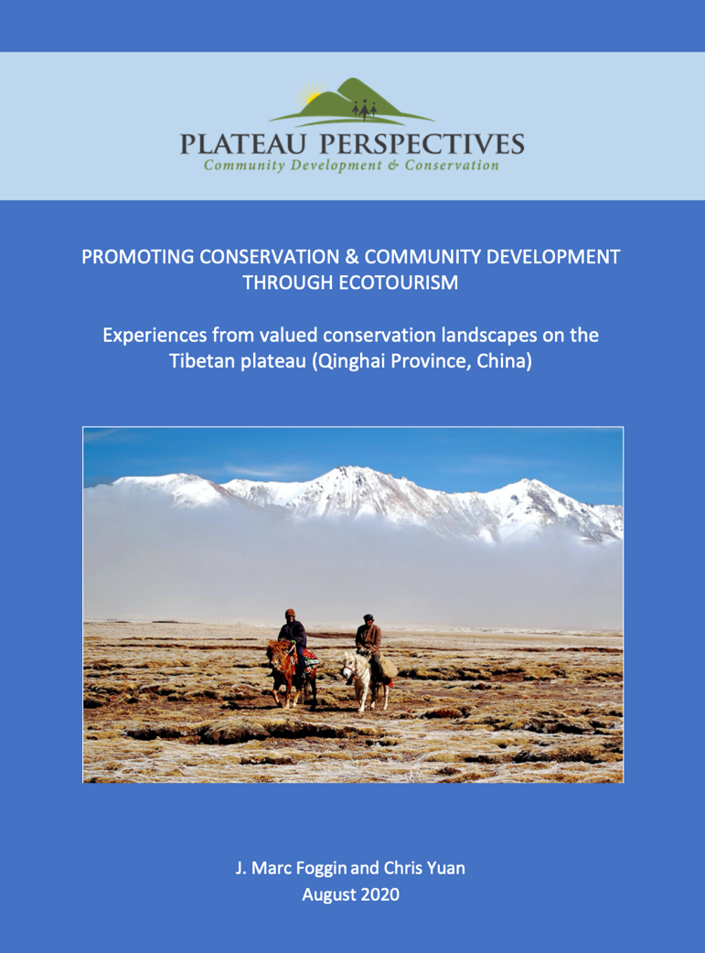
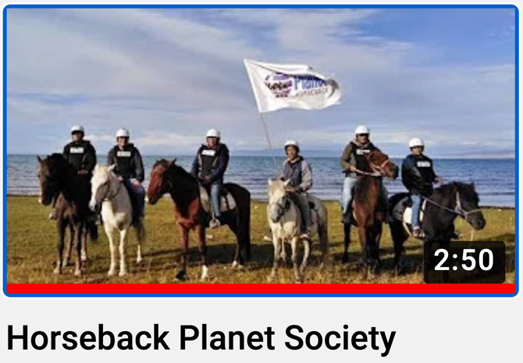
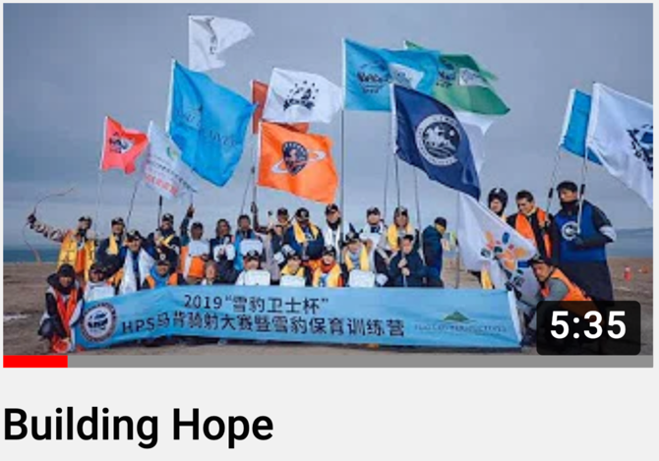
Horseback Planet Society and community partnerships
Community-based ecotourism entreprises encouraged and supported, then developed as partners for mutual benefit
Household businesses are naturally replicating – providing employment, serving as models to others, providing hope
New activities trialed – some kept, while others discarded
Notes:
With our partners at Horseback Planet Society, we have focused attention on a local cultural asset – horses. In this, it is local community partners who are the expert. However, a variety of new elements also can be added to the mix of tourism experiences – including enhanced health and safety measures and improved customer experiences (service sector), on one hand, and introduction of activities such as rafting and bird watching, on the other hand.

Slide 9
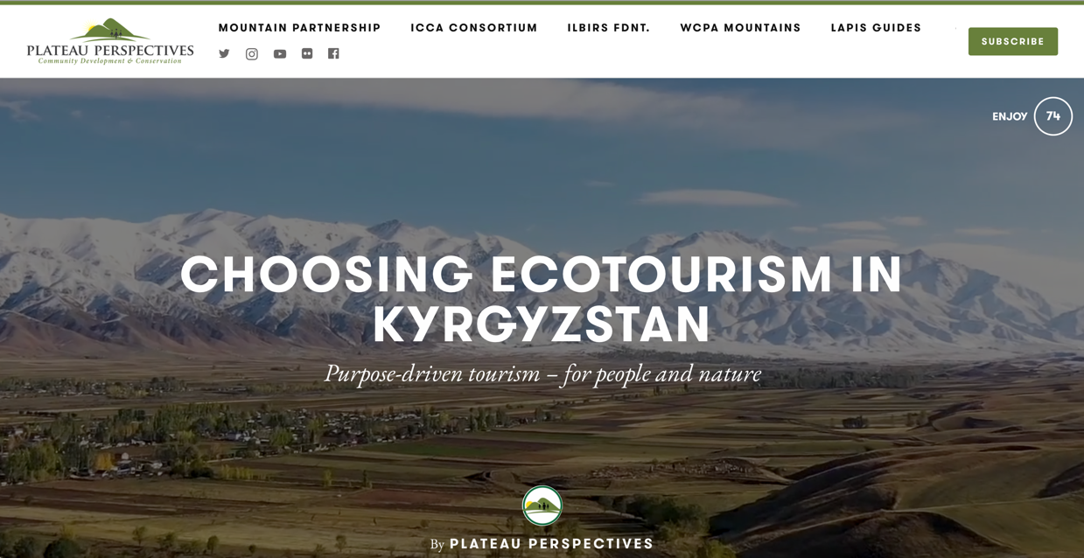
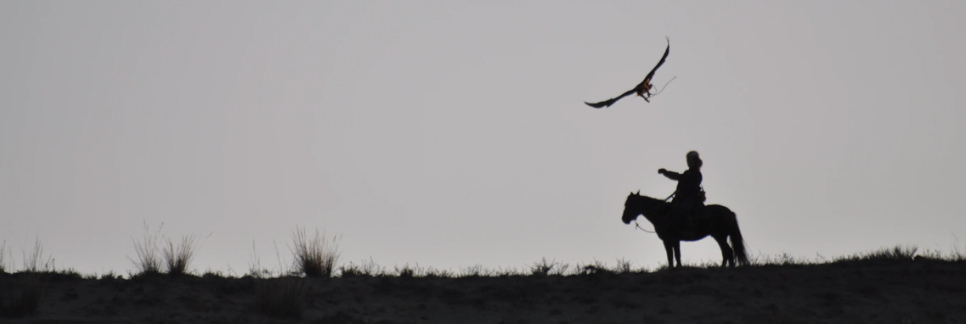
Community-managed micro reserve in Tianshan Mountains
Opportunism – creatively taking advantage of emerging opportunities as they arise
Resilience – ability to withstand unexpected changes, strengthened by local relationships
New opportunities could include…
  Leveraging new legislations
  Building new partnerships
  Destination marketing
  Or collaborations with international biodiversity projects… focusing on ecotourism-for-conservation
Notes:
This model is an excellent example of ‘opportunism’ – that is, taking new opportunities as they arise, and leverage these for local benefit! In this case, a change in national legislation regarding land use allowed the community to bid for the right to use several valleys as they saw fit – as long as they could clearly demonstrate that they did not harm the environment. They won the bid, and are now ‘using’ the resources (incl. natural scenery and horse riding) while demonstrating their impact (or lack thereof) through a grassland monitoring program and a wildlife camera-trap monitoring program. Not only are they not harming the natural environment, they are showing positive trends in the mountain wildlife populations!

Slide 10
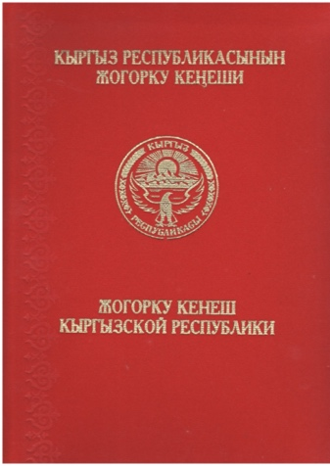
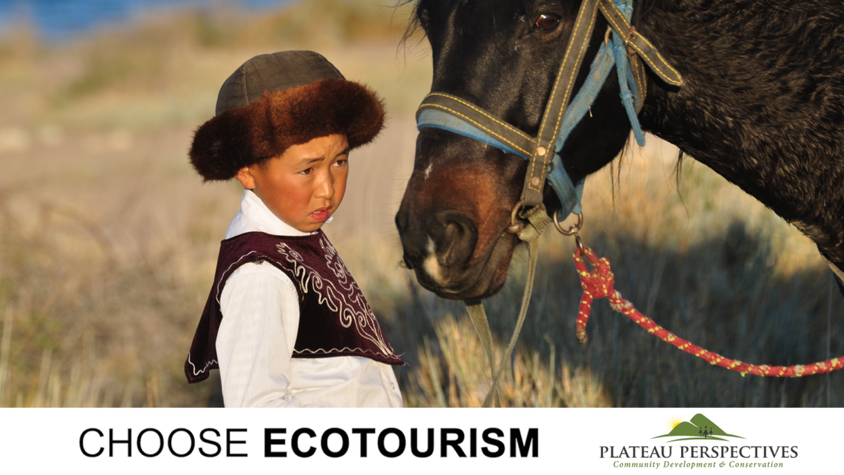
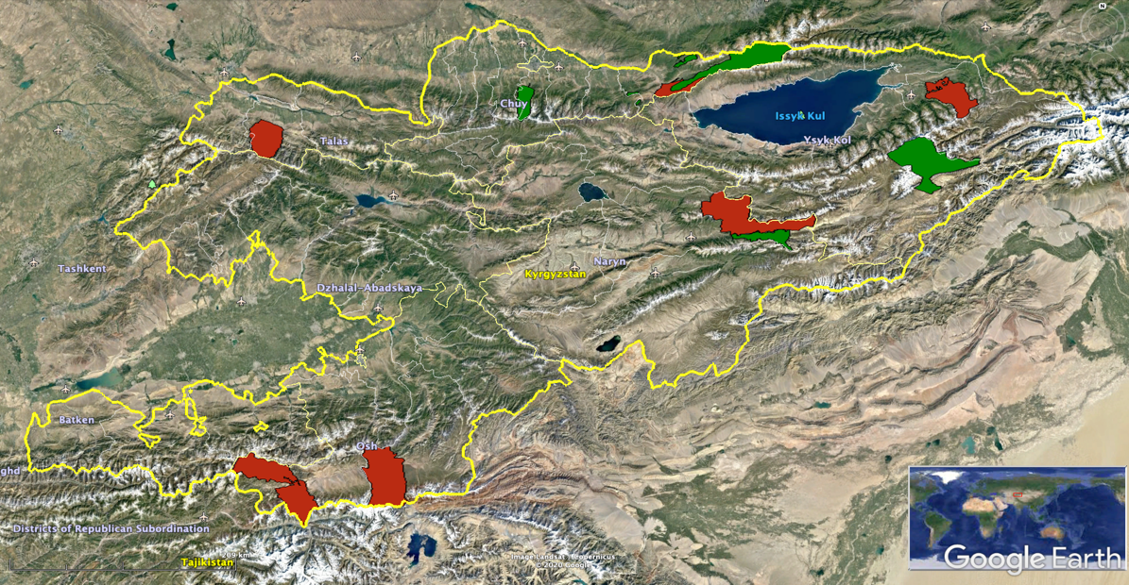
Community conservancies and local wardens
Short documentary film on ecotourism in Central Asia produced by Marc Foggin & Pavel Bolshakova, 2020
Network of “community conservancies” around Kyrgyzstan, including Ecotours
  Building on local community interests
  Developing ecotourism in tandem with environmental conservation goals
Notes:
There is also a good network of community conservancies across Kyrgyzstan, and this could be expanded elsewhere as well. Former poachers are now serving as wildlife monitors and nature guides. They now form the backbone of local environmental monitoring as well as anti-poaching and enforcement, and they have developed guesthouses, rent their horses, serve as nature guides, provide food, and more. Conservation is enhanced and the local economic is benefiting. In my opinion, this is one of the most exciting models around.
From one joint project that we undertook together in October 2019, I co-produced a short 20-minute documentary film that presents this approach. This film aims to be much more than publicity for Kyrgyzstan, or for any particular community initiative – it seeks also to offer a message of hope, a reminder of the future we want. It is a reminder of Ecotourism serving conservation and community development purposes… of Ecotourism as meeting a range of local and national goals, not only measured from the perspectives of economics.

Slide 11
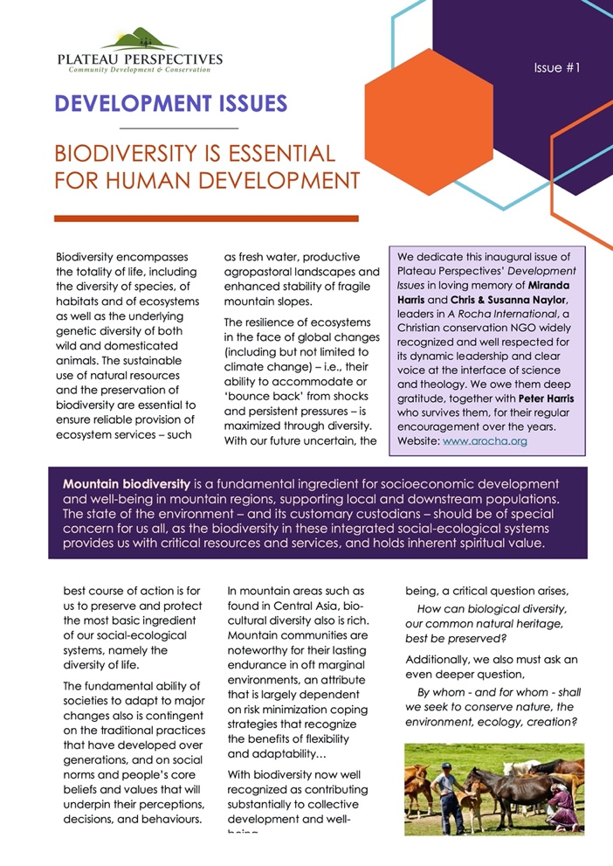
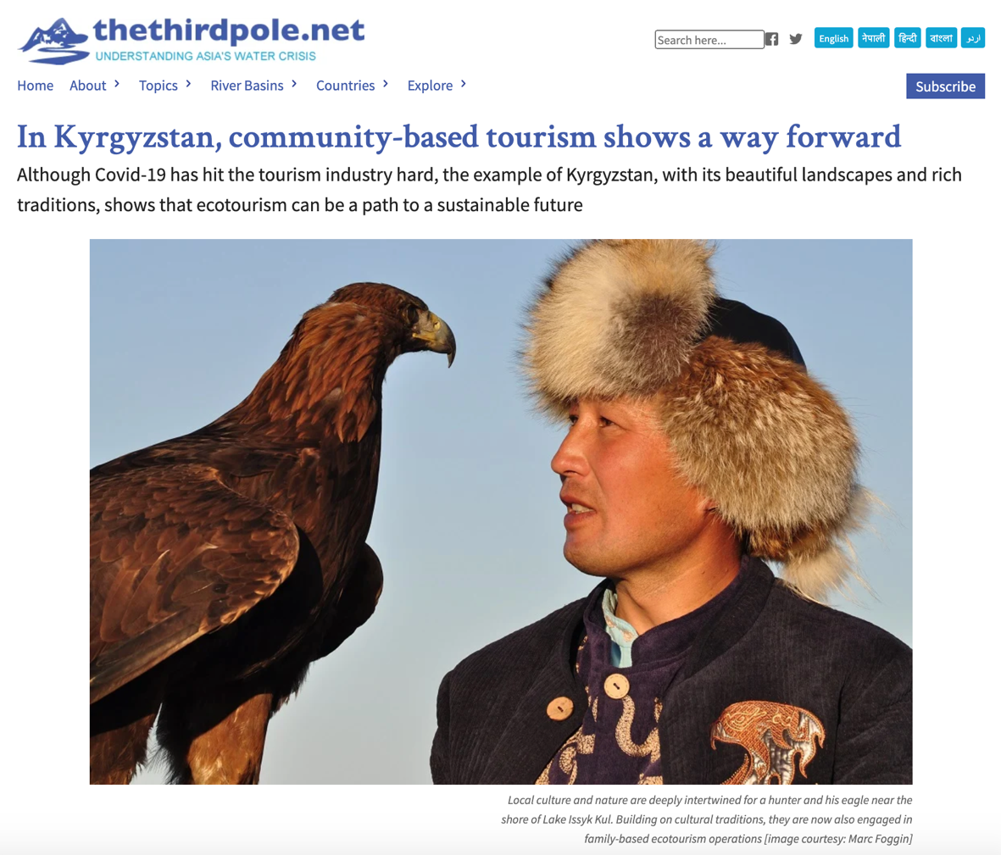
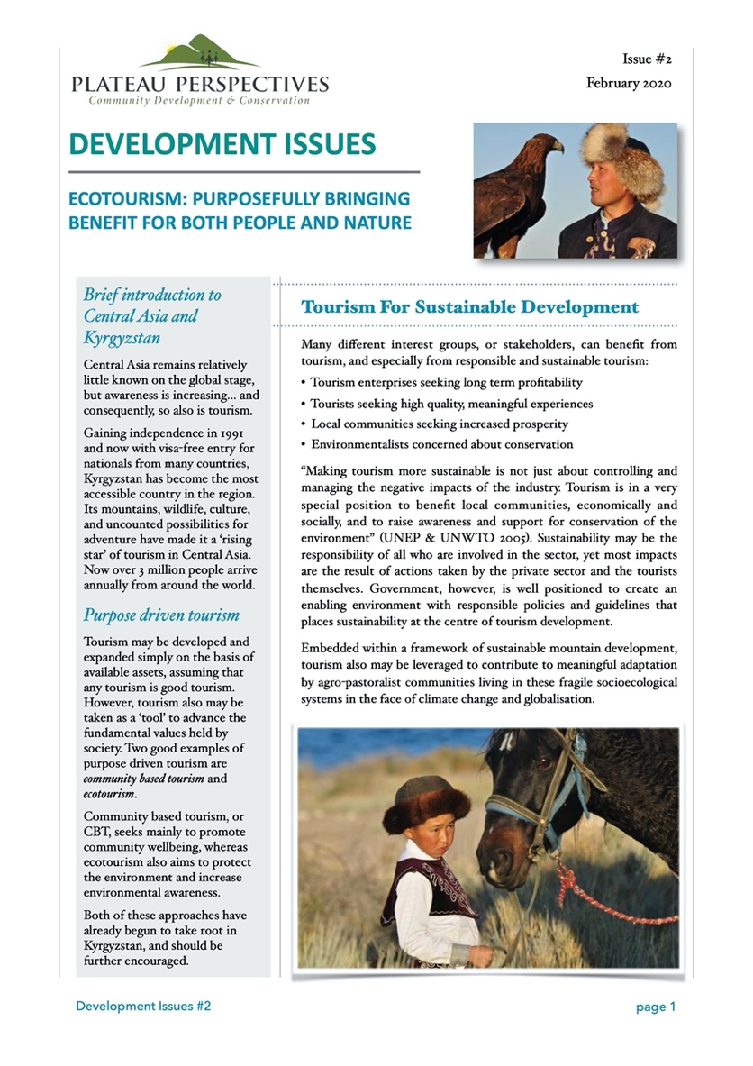
What next?
Charting the future development of ecotourism and other forms of purpose-driven tourism in Uzbekistan
Notes:
Over the last several months, with the travel restrictions due to Covid-19, we have actually taken this unexpected opportunity to produce several materials that may be of interest to you – all of which are freely available. There are several policy briefs, photo stories, and most recently also an interview published online…
We look forward now to taking these experiences, and to apply them to the Uzbek context. But it is only in discussion and dialogue that we can find the right and best ways forward.

Slide 12

Dr J Marc Foggin
International Director, Plateau Perspectives
Research Associate, Institute of Asian Research, School of Public Policy and Global Affairs, University of British Columbia marc.foggin@ubc.ca
Thank you !
Charting the future development of ecotourism and other forms of purpose-driven tourism in Uzbekistan
Notes:
Thank you for inviting me today and for providing the opportunity to share with you from our ideas and experiences.
CONTACT: Marc Foggin, marc.foggin@gmail.com
LINKS INCLUDED IN THE POWERPOINT:
https://www.mdpi.com/2073-445X/7/2/52
http://plateauperspectives.org/wp-content/uploads/HPS-2020.pdf
https://www.youtube.com/watch?v=MOrgYSPDCY8&feature=youtu.be
https://www.youtube.com/watch?v=73kWQTu9ymA&feature=youtu.be
https://stories.plateauperspectives.org/choose-ecotourism
http://plateauperspectives.org/en/ecotourism-project-2019/
https://www.youtube.com/watch?v=fuDZa3Qd5hY&feature=youtu.be
http://ilbirs.org/ecotours?lang=en
http://plateauperspectives.org/wp-content/uploads/Biodiversity.pdf
http://plateauperspectives.org/wp-content/uploads/Ecotourism.pdf
https://www.thethirdpole.net/2020/07/31/in-kyrgyzstan-community-based-tourism-shows-a-way-forward/
http://plateauperspectives.org/

